Slide 1
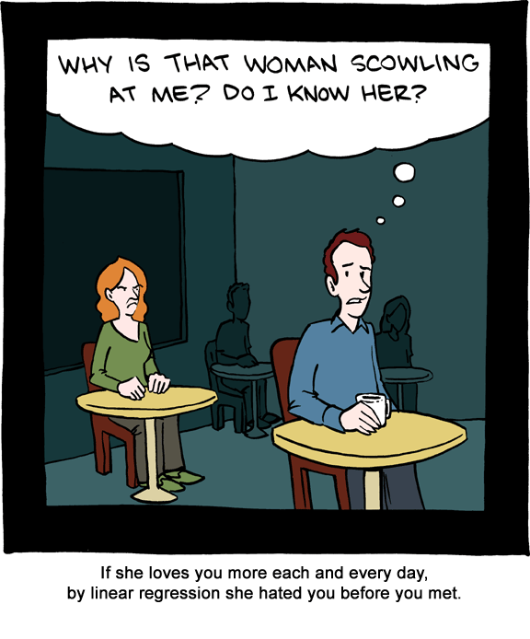
Chapter 12: Correlation and Linear Regression
http://jonfwilkins.blogspot.com/2011_08_01_archive.html

Slide 2
12.2 (Part A) Hypothesis Tests Goals
Be able to determine if there is an association between the response and explanatory variables using the F test.
Be able to perform inference on the slope (Confidence interval and hypothesis test).

Slide 3
Inference
Association
Intercept
b₀ is an unbiased estimator for β₀
slope
b₁ is an unbiased estimator for β₁

Slide 4
Hypothesis Tests
F test or model utility test
t test for the slope

Slide 5
LR Hypothesis Test: F-test Summary
H₀: there is no association between X and Y
H_{a}: there is an association between X and Y
Test statistic: F_{ts} $=\frac{MSR}{MSE}$
P-value: P = P(F > F_{ts}), df1 = dfr = 1, df2 = dfe = n - 2

Slide 6
Standard deviation for b₁
$$b_{1}=\frac{\sum{\left[\left(x_{i}−\overline{x}\right)\left(y_{i}−\overline{y}\right)\right]}}{\sum{{\left(x_{i}−\overline{x}\right)}^{2}}}=\sum{a_{i}y_{i}}$$
$$σ_{b_{1}}=σ\sqrt{\sum{a_{i}^{2}}}=\frac{σ}{\sqrt{\sum{{(x_{i}−\overline{x})}^{2}}}}=\frac{σ}{\sqrt{S_{xx}}}$$
(Bonus on HW)
$${SE}_{b_{1}}=s_{b_{1}}=\frac{s}{\sqrt{\sum{{(x_{i}−\overline{x})}^{2}}}}=\frac{s}{\sqrt{S_{xx}}}=\sqrt{\frac{MSE}{S_{xx}}}$$

Slide 7
Confidence Interval for β₁
$b_{1}±t_{α/{2,df}}^{}{SE}_{b1}$ =
$$b_{1}±t_{α/{2,n−2}}^{}\sqrt{\frac{MSE}{S_{xx}}}$$

Slide 8
LR Hypothesis Test: t test Summary
Null hypothesis: H₀: β₁ = β₁₀
Test statistic: $\frac{b_{1}−β_{10}}{\sqrt{\frac{MSE}{S_{xx}}}}$
Note: A two-sided test with β₁₀ = 0 is the F test
 | Alternative Hypothesis | P-Value
Upper-tailed | H_{a}: β₁ > β₁₀ | P(T ≥ t)
Lower-tailed | H_{a}: β₁ < β₁₀ | P(T ≤ t)
two-sided | H_{a}: β₁ ≠ β₁₀ | 2P(T ≥ |t|)

Slide 9
12.2 (Part B): Correlation - Goals
Be able to use (and calculate) the correlation to describe the direction and strength of a linear relationship.
Be able to recognize the properties of the correlation.
Be able to determine when (and when not) you can use correlation to measure the association.

Slide 10
Sample Correlation
The sample correlation, r, is measure of the strength of a linear relationship between two continuous variables.
This is also called the Pearson’s Correlation Coefficient

Slide 11
Comments about Correlation
Correlation makes no distinction between explanatory and response variables.
$$r=\frac{\sum{\left[\left(x_{i}−\overline{x}\right)\left(y_{i}−\overline{y}\right)\right]}}{\sqrt{\sum{{\left(x_{i}−\overline{x}\right)}^{2}}}\sqrt{\sum{{\left(y_{i}−\overline{y}\right)}^{2}}}}=\frac{{SS}_{xy}}{\sqrt{SS_{xx}}\sqrt{{SS}_{yy}}}=\frac{\sum{\left[\left(x_{i}−\overline{x}\right)\left(y_{i}−\overline{y}\right)\right]}}{(n−1)s_{x}s_{y}}=\frac{1}{n−1}\sum{\left[\left(\frac{x_{i}−\overline{x}}{s_{x}}\right)\left(\frac{y_{i}−\overline{y}}{s_{y}}\right)\right]}$$
r has no units and does not change when the units of x and y change.

Slide 12
Properties of Correlation
r > 0 ==> positive association
r < 0 ==> negative association
r is always a number between -1 and 1.
The strength of the linear relationship increases as |r| moves to 1.
|r| = 1 only occurs if there is a perfect linear relationship
r = 0 ==> x and y are uncorrelated.

Slide 13
Variety of Correlation Values

Slide 14
Value of r

Slide 15
Cautions about Correlation
Correlation requires that both variables be quantitative.
Correlation measures the strength of LINEAR relationships only.
The correlation is not resistant to outliers.
Correlation is not a complete summary of bivariate data.

Slide 16
Questions about Correlation
Does a small r indicate that x and y are NOT associated?
Does a large r indicate that x and y are linearly associated?

Slide 17
12.4: Regression Diagnostics - Goals
Be able to state which assumptions can be validated by which graphs.
Using the graphs, be able to determine if the assumptions are valid or not.
If the assumptions are not valid, use the graphs to determine what the problem is.
Using the graphs, be able to determine if there are outliers and/or influential points.
Be able to determine when (and when not) you can use linear regression and what you can use it for.

Slide 18
Assumptions for Linear Regression
SRS with the observations independent of each other.
The relationship is linear in the population.
The standard deviation of the response is constant.
The response, y, is normally distribution around the population regression line.

Slide 19
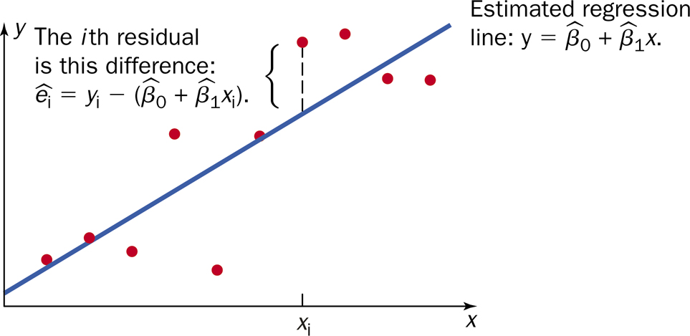
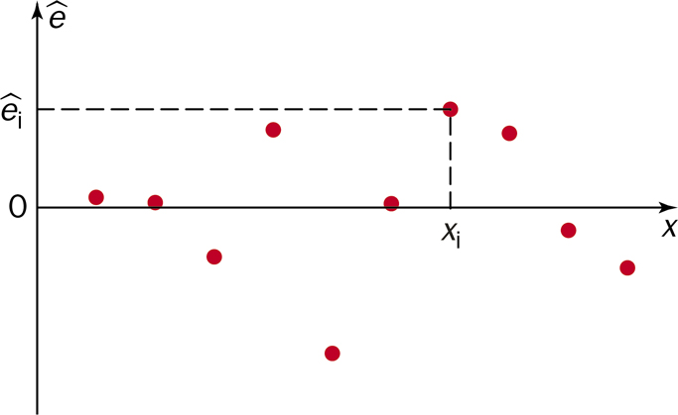
Concept of Residual Plot

Slide 20
Why a residual plot is useful?
It is easier to look at points relative to a horizontal line vs. a slanted line.
The scale is larger.

Slide 21
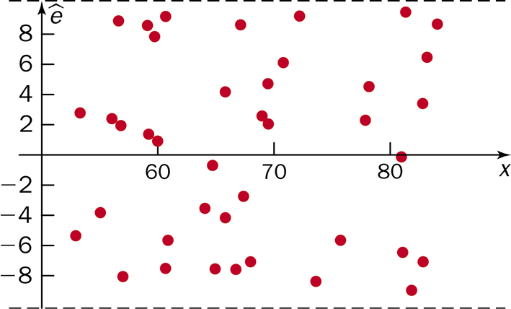
No Violations
If there are no violations in assumptions, scatterplot should look like a horizontal band around zero with randomly distributed points and no discernible pattern.

Slide 22
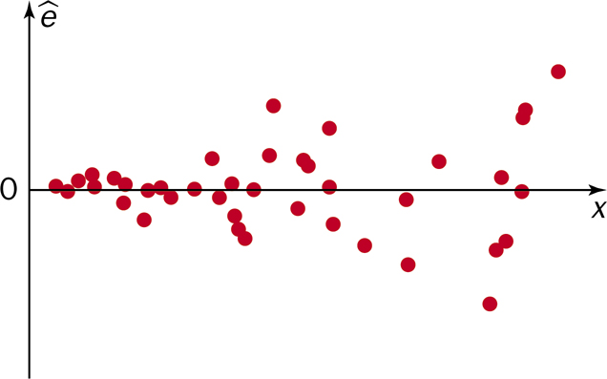
Non-constant variance

Slide 23
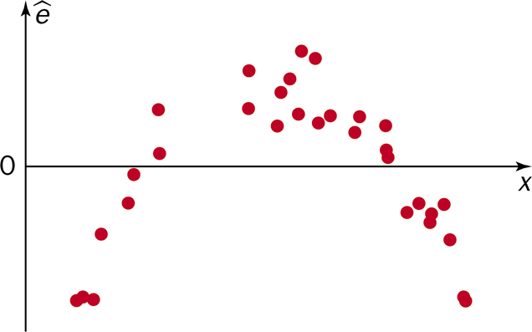
Non-linearity

Slide 24
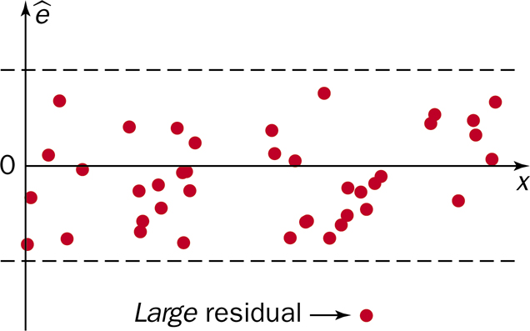
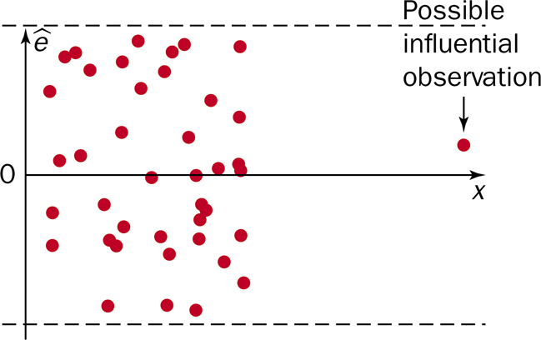
Outliers

Slide 25
Assumptions/Diagnostics for Linear Regression
Assumption | Plots used for diagnostics
SRS | None
linear | Scatterplot, residual plot
Constant variance | Scatterplot, residual plot
Normality of residuals | QQ-plot, histogram of residuals

Slide 26
Cautions about Correlation and Regression:
Both describe linear relationship.
Both are affected by outliers.
Always PLOT the data.
Beware of extrapolation.
Beware of lurking variables
Correlation (association) does NOT imply causation!

Slide 27
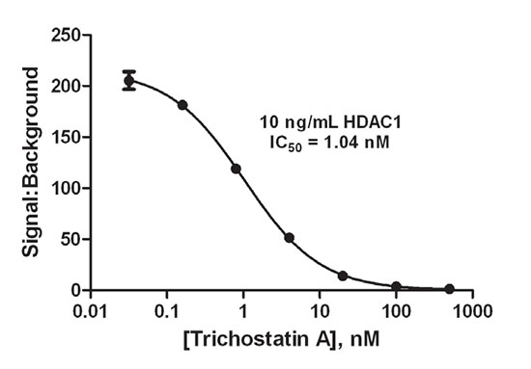
Cautions about Correlation and Regression: Extrapolation

Slide 28
12.3: Inferences Concerning the Mean Value and an Observed Value of Y for x = x* - Goals
Be able to calculate the confidence interval for the mean value of Y for x = x*.
Be able to calculate the confidence interval for the observed value of Y for x = x* (prediction interval)
Be able to differentiate these two confidence intervals from each other and the confidence interval of the slope.

Slide 29
SE_{µ̂*}
$${SE}_{{\hat{μ}}^{∗}}=\sqrt{MSE\left[\frac{1}{n}+\frac{{\left(x^{∗}−\overline{x}\right)}^{2}}{S_{XX}}\right]}$$

Slide 30
SE_{ŷ}
Variance Components of prediction value
Variance associate with the mean response
$${SE}_{\hat{μ}∗}=\sqrt{MSE\left[\frac{1}{n}+\frac{{\left(x^{∗}−\overline{x}\right)}^{2}}{S_{XX}}\right]}$$
Variance associated with the observation
$${SE}_{\hat{y}∗}=\sqrt{MSE\left[1+\frac{1}{n}+\frac{{\left(x^{∗}−\overline{x}\right)}^{2}}{S_{XX}}\right]}$$

Slide 31
Intervals
Confidence interval for the mean at x*
$${\hat{y}}_{x^{∗}}±t_{α/{2,n−2}}\text{SE}\text{µ̂}\text{*}$$
Prediction interval for the next point at x*
$${\hat{y}}_{x^{∗}}±t_{α/{2,n−2}}{SE}_{\hat{y}∗}$$

Slide 32
Example: Confidence/Prediction Band

